Slide 1
Linked Data/Semantic Web

Slide 2

Henning Kongsgård
Chief Enterprise Architect, Cobuilder

Slide 3
It’s all about data.
Fit-for-purpose and accurate product data improves quality of service, time to market and reduces time, cost and environmental footprint

Slide 4
Why standards?

Slide 5



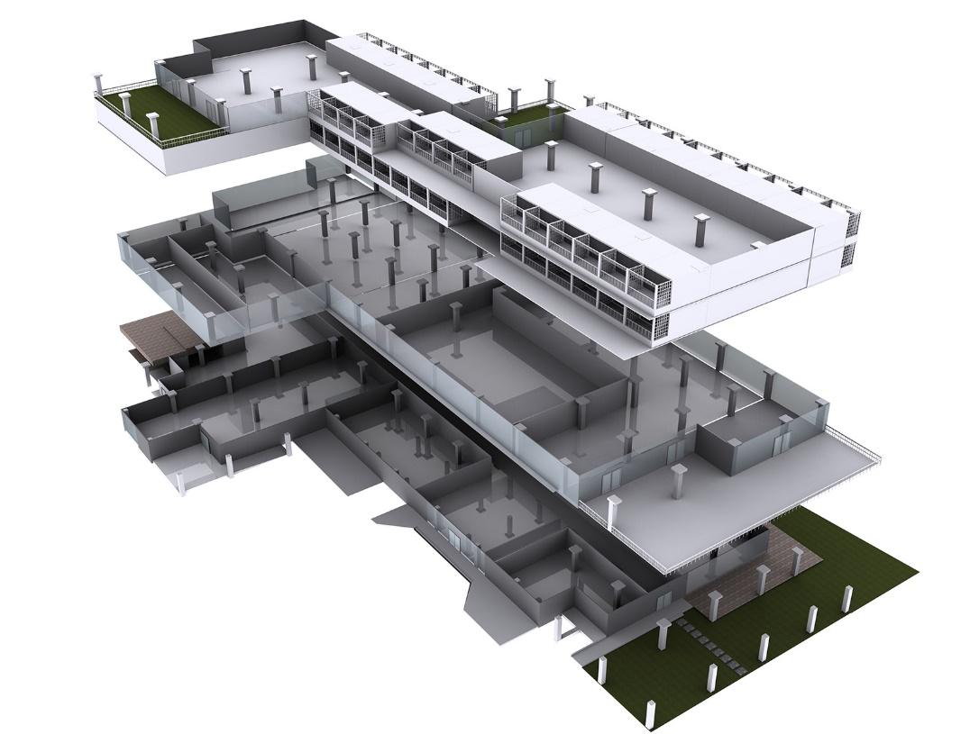




Thermal Transmittance
Heat transfer
Thermal Transmittance
Thermal conductivity
U-value
Thermal resistance

Slide 6


Contractual agreement
Thermal Transmittance
acc. to EN ISO 10077-1
Thermal Transmittance
acc. to EN 14351-1
Thermal Transmittance
acc. to EN ISO 10077-2
Thermal Transmittance
acc. to EN ISO 12567-1
Thermal Transmittance
acc. to EN ISO 12567-2

Slide 7


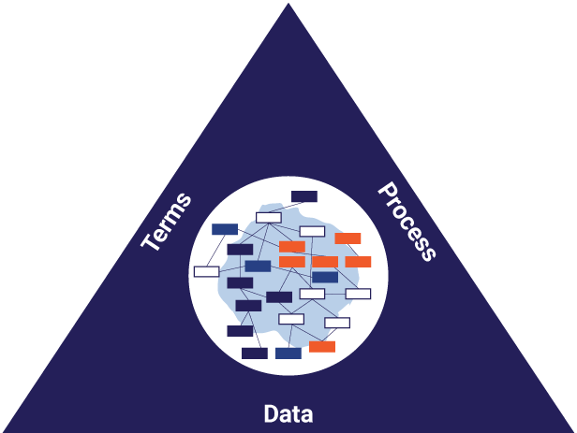
ISO 12006-3 - Framework for object-oriented information
ISO 12006-3 (IFD)
ISO 29481 (IDM)
ISO 16739 (IFC)

Slide 8
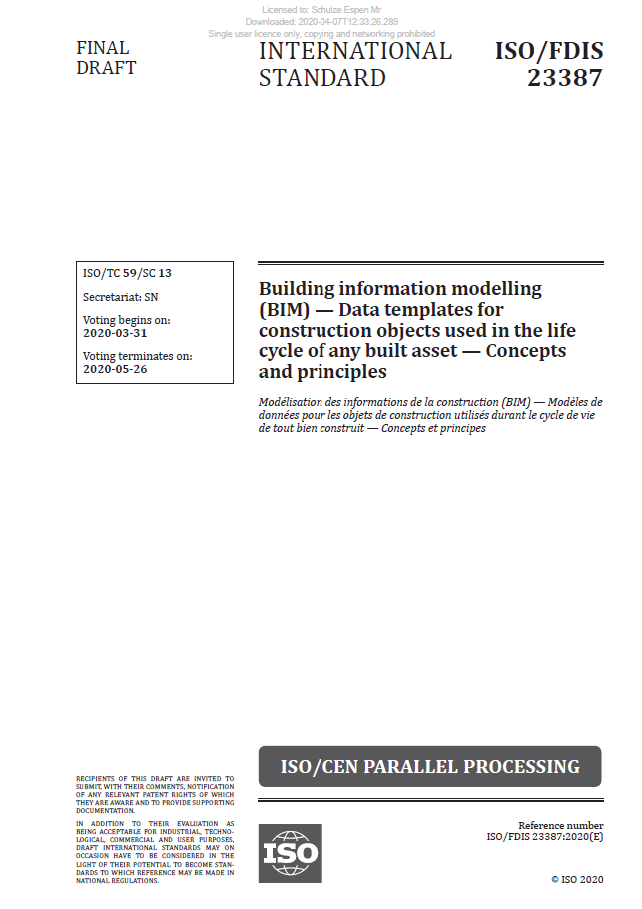
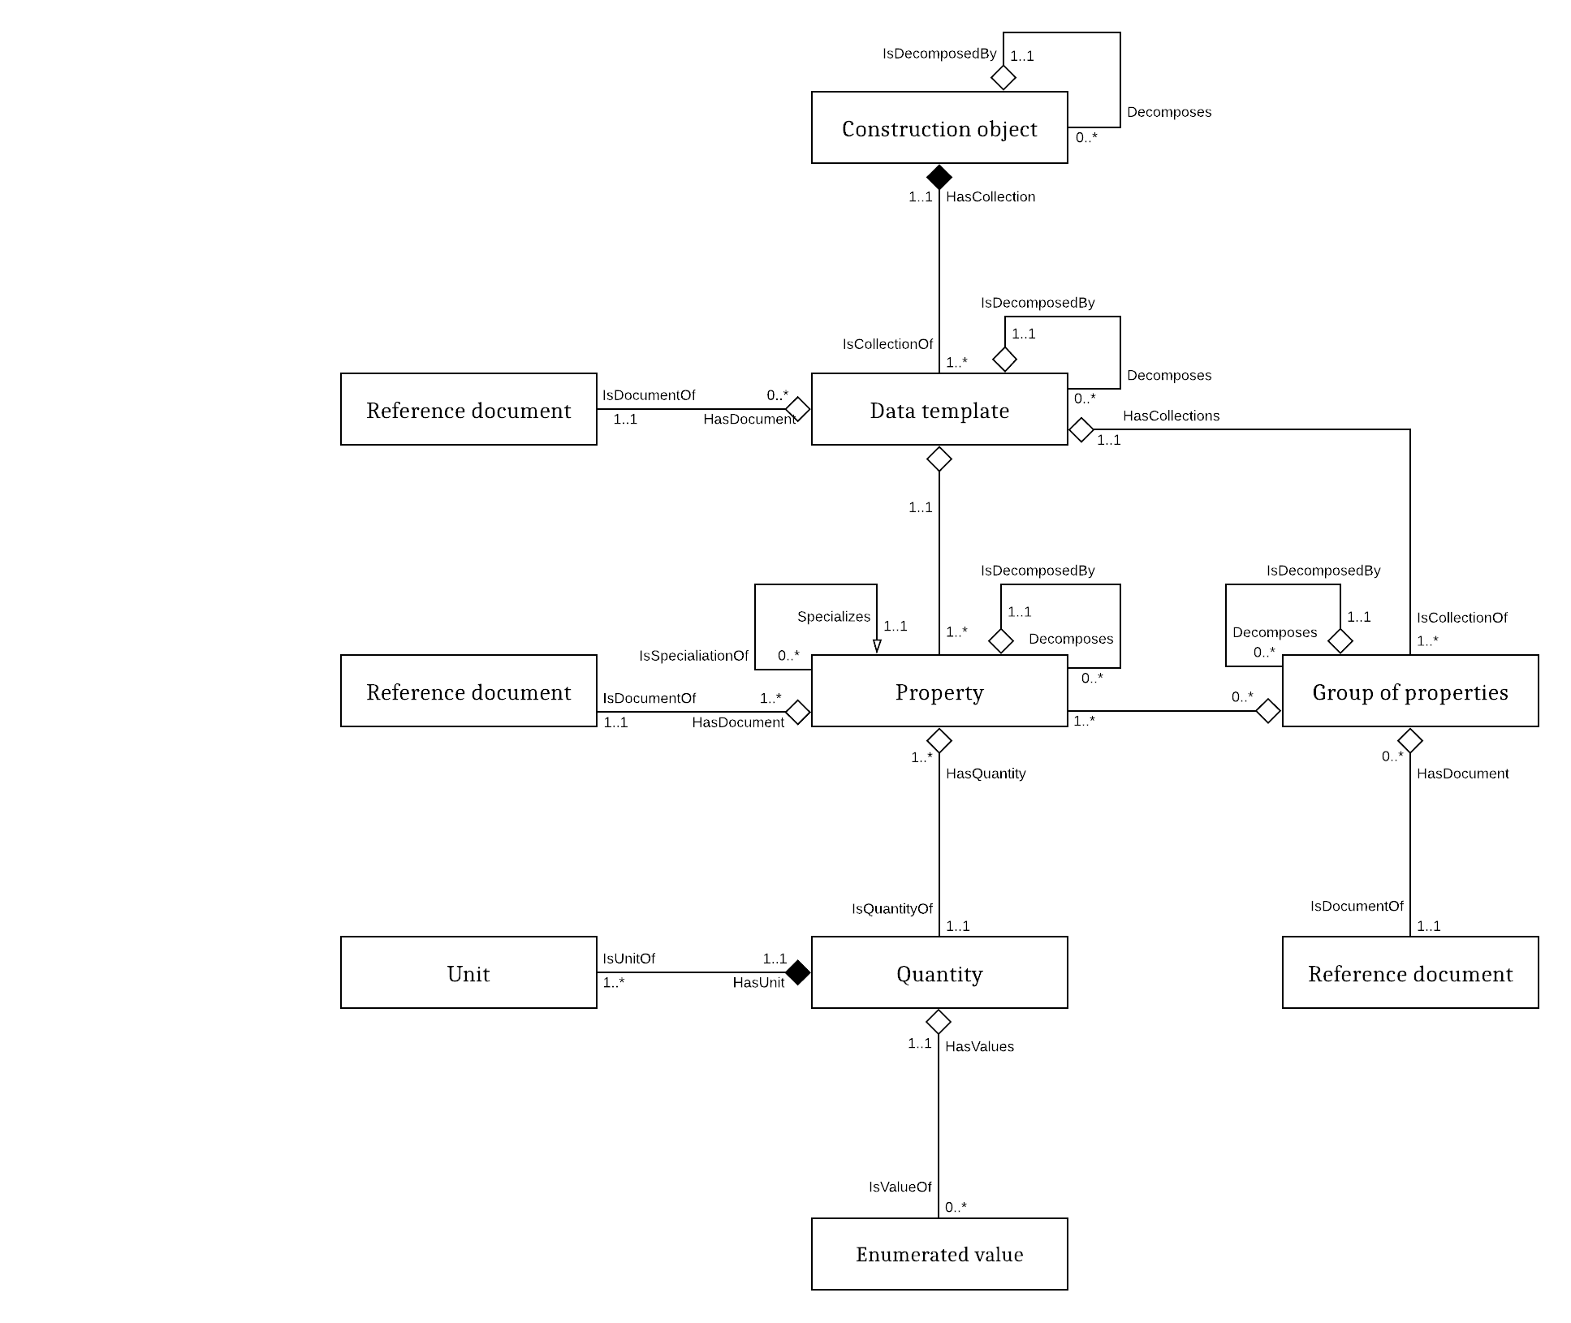
ISO 23387 – Data structure for data templates
Provides

Slide 9
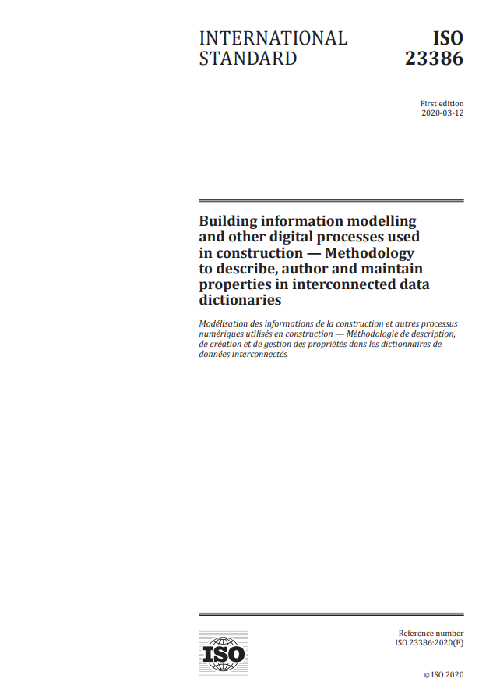



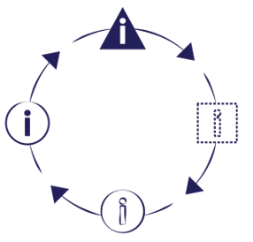



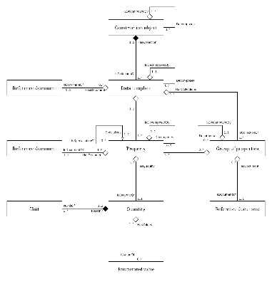

ISO 23386 –
Expert process/
trusted content
ISO 19650 - Information management
Information
exchanges
ISO 12006-3/
ISO 23387 –
Standardized
data structure

Slide 10
Where does this fit with Linked Data?

Slide 11
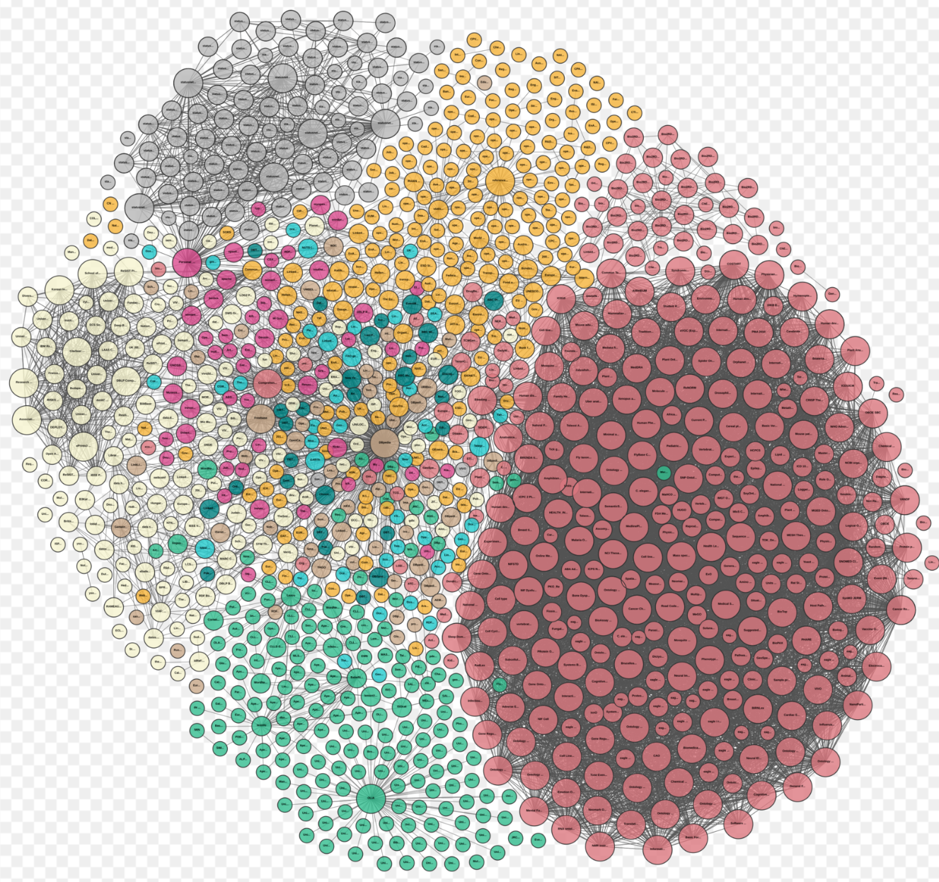

WI 442021: Semantic Modelling and Linking Standard (SMLS) for data integration in the built environment
TC 442

Slide 12
TC 442
WI 442021: Semantic Modelling and Linking Standard (SMLS) for data integration in the built environment
EN ISO 23386, Methodology to create properties EN ISO 23387, Structure for Data Templates

Slide 13
ISO 12006-3 - Framework for object-oriented information
EXPRESS
Linked Data

Slide 14
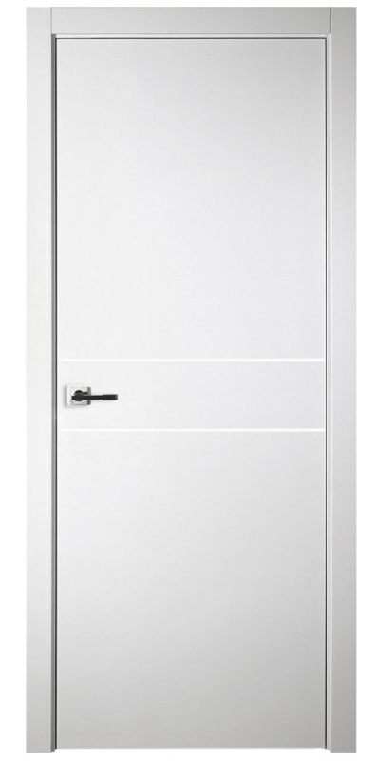
Example (OWL / Turtle)
ex:Door a owl:Class .
ex:height a owl:ObjectProperty ;
rdfs:range smls:QuantityValue ;
smls:quantityKind quantitykind:Length .
ex:clearOpeningHeight a owl:ObjectProperty ;
skos:definition “height measured from top threshold to bottom of stop”@en ;
rdfs:subPropertyOf ex:height ;
rdfs:domain ex:Door ;
rdfs:seeAlso "EN12519" ; -- example external reference
pdt:languageCode nace:FR ; -- example CEN PDT meta-data
pdt:dateOfVersion “2019-11-06T16:10” . -- example CEN PDT meta-data
ex:Door_1 a ex:Door ;
ex:ClearOpeningHeight [rdf:value 2.40 ;
smls:unit unit:M ;
ex:hasAccuracy 85.5 ;
ex:measuredBy “Somebody" ; ] .
ex:PropertyDefSet_1 a rdfs:Container ;
rdfs:member ex:clearOpeningHeight .
Meta-data in bold

Slide 15
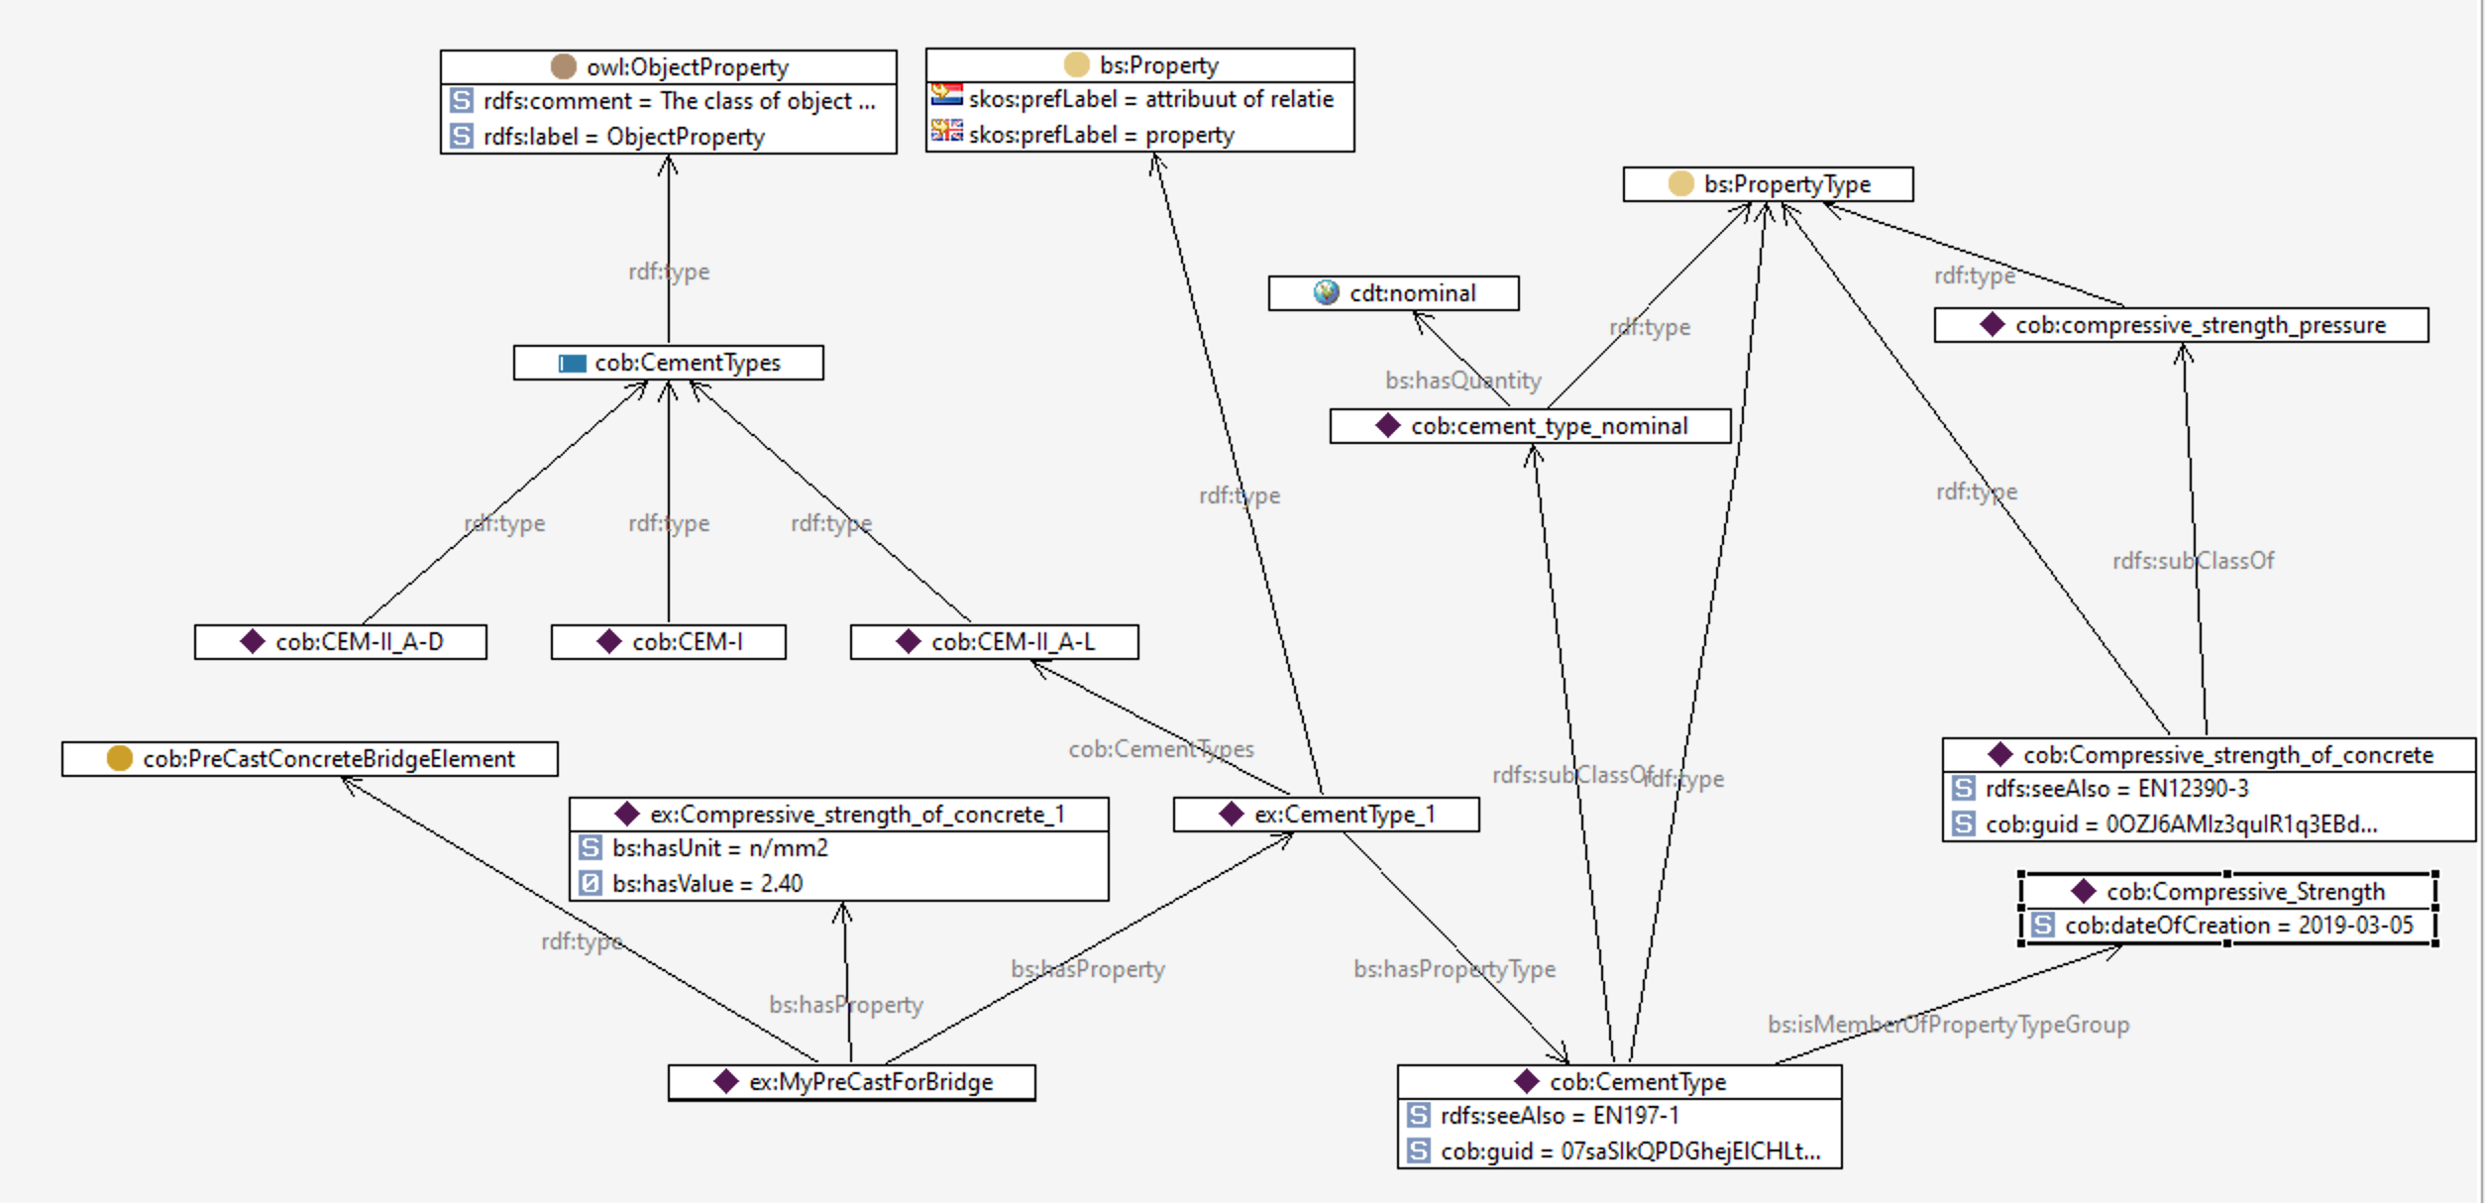
Precast concrete bridge element

Slide 16
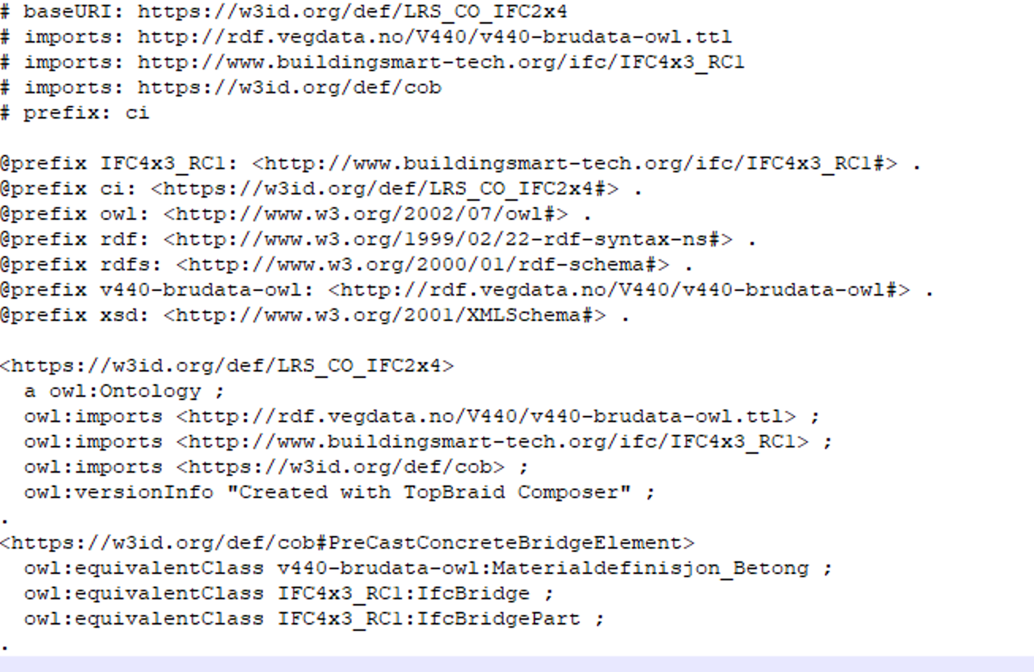
Linking Rule Set

Slide 17
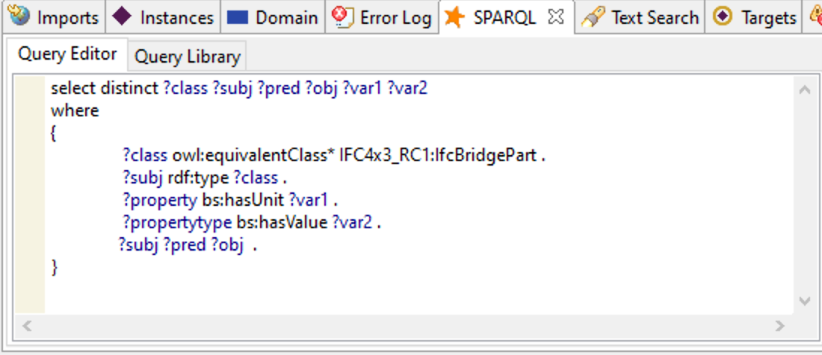
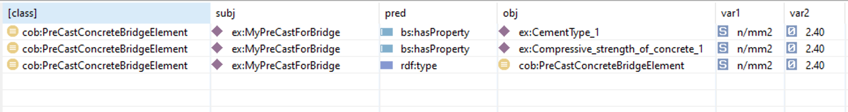
Precast concrete bridge element

Slide 18


Thank you for the attention!
kongsgard@cobuilder.no
@HKongsgaard

